Slide 1
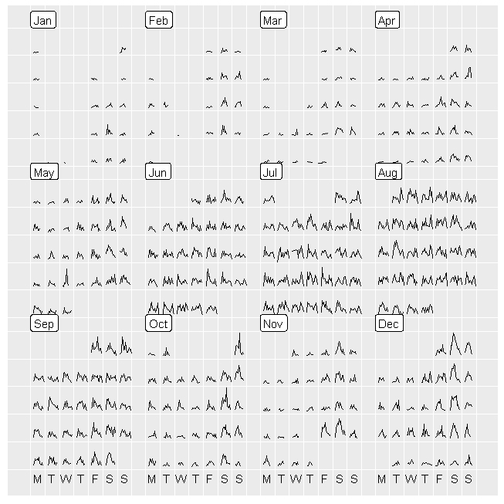
Levels
Dark Grey – Off Season Minimum
Brown - Winter Saturdays
Tan – Spring Fri Sat
Pastel Green – Spring Sundays
Yellow – MOD weekday (May, Oct, Dec)
Bold Green – Jun Sep Weekdays
Pastel Blue – Peak 6 Days
Red – Peak Sundays
Purple – Fall Weekend
Bright blue – Xmas Peak

